Slide 1
Target genes identification
Aled Jones

Slide 2
start with vcf
phenotype
ontologies
filtering/prioritisation
common population variants
exac, evs, dbsnp, allele freq community
disease specific populations
annotation
in silico tools
-conservation
best practice guidelines -american/Uk
reporting classification

Slide 3
What are we trying to do?

Slide 4
We have:
a vcf containing all the calls
We want…
the causative variant(s)

Slide 5
How??

Slide 6
How??
Remove common variants
Remove low quality variant calls
Look for previously reported variants
Use in silico tools to predict the impact a variant has on gene function
Ideally confirm with functional studies (RNA, animal model) but not feasible in clinical setting.

Slide 7
Challenges
We have many variants!
Hard to classify
Understanding of what is pathogenic is constantly changing

Slide 8
Guidelines

Slide 9
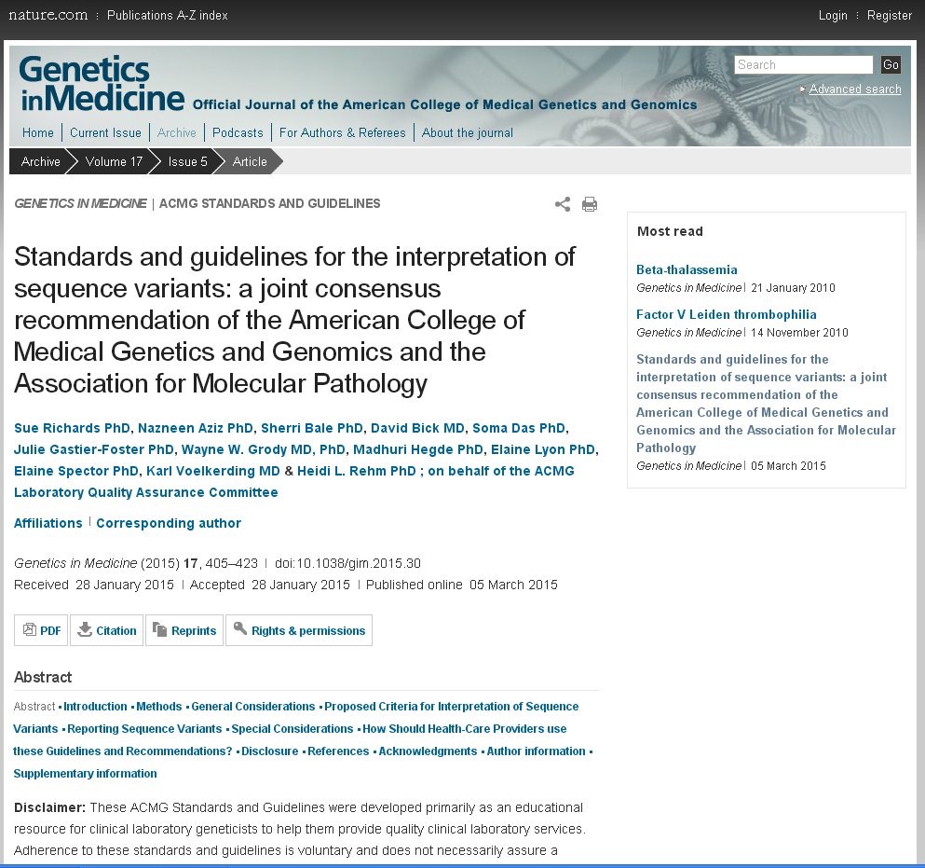
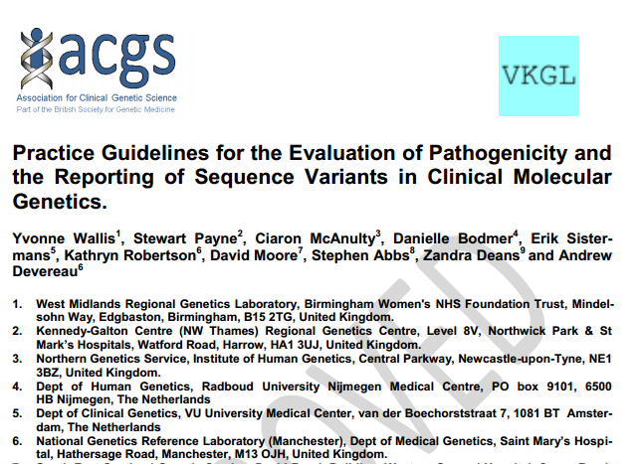
Best Practice Guidelines
How to classify and report variants
Association of Clinical Genetic Science (UK):
http://www.acgs.uk.com/media/774853/evaluation_and_reporting_of_sequence_variants_bpgs_june_2013_-_finalpdf.pdf
American College of Medical Genetics
doi:10.1038/gim.2015.30

Slide 10
Best Practice Guidelines
Cover how to weight different types of evidence
What to consider when using a resource
What to put in a report
Terminology to use
Types of classification for variants
American standards attempts to define exactly what evidence is required to classify a variant at each classification

Slide 11
Classification
Class 1 Clearly not pathogenic
Class 2 Unlikely to be pathogenic
Class 3 Unknown significance
Class 4 Likely to be pathogenic
Class 5 Clearly pathogenic

Slide 12
Good Scientific Practice
To ensure reproducibility:
Create a SOP for analysis - tools to interrogate
Follow SOP and record the findings at each step for each variant.

Slide 13
Filtering/prioritisation

Slide 14
Regions of interest
WES allows virtual gene panels to be applied.

Slide 15
Control populations
Variants with a minor allele frequency (MAF) above 1% in control populations are unlikely to cause rare disease
ExAC ( Exome Aggregation Consortium):
Allele frequencies from WES of 60,706 healthy and diseased individuals
1000 genomes
WGS of 2,504 samples
EVS (Exome variant server) **
WES of 6500 heart, lung and blood disorders
**Not suitable for use as a control for patients with cardiac conditions

Slide 16
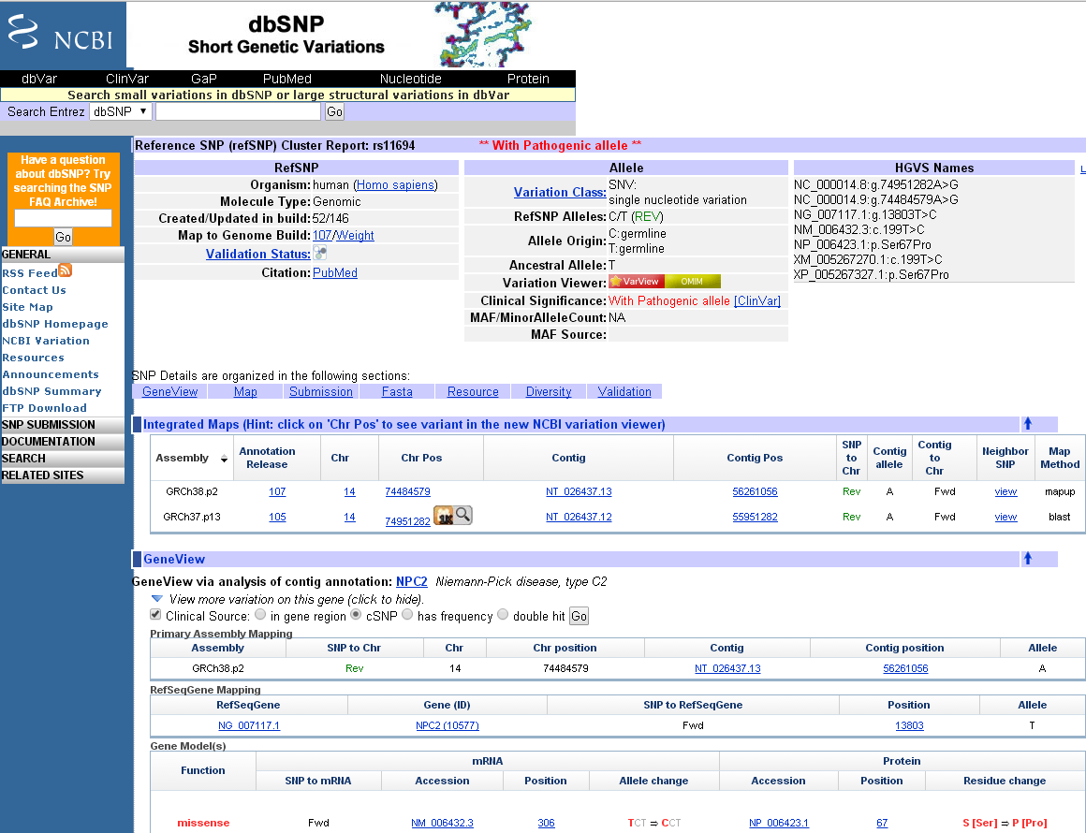
dbSNP - catalog of variants
Neither control or disease!
each SNP is given a unique rs#
each reported SNP has a ss#
links to ClinVar
HGVS nomenclature

Slide 17
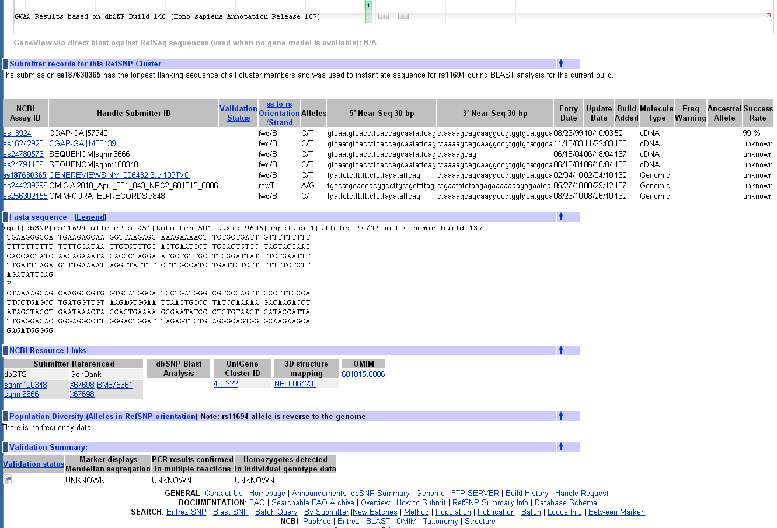
dbSNP - catalog of variants
each SNP is given a unique rs#
each reported SNP has a ss#
links to ClinVar
HGVS nomenclature

Slide 18
Disease specific databases
HGMD
paid for database of pathogenic reported variants
ClinVar
reported variants and classification*
LOVD - locus specific databases
curated repository of pathogenic variants within a single gene
Use LOVD database structure
http://www.hgvs.org/locus-specific-mutation-databases/?field_hgnc_gene_symbol_title=
Many disease specific repositories:
retinal dystrophies: http://www.retina-international.org/sci-news/databases/mutation-database
*classification is not curated

Slide 19
Literature
Literature

Slide 20
Beware
Don’t blindly trust someone else’s classification
A recent study into cardiomyopathies showed that more than 10% (11.7%, 19.6% and 20.1%) of individuals in ExAC have a variant classified as pathogenic in HGMD in one of the three most common genes (HCM, DCM and ARVC)
http://dx.doi.org/10.1101/041111
Variants can be in multiple databases/repositories!

Slide 21
In silico tools

Slide 22
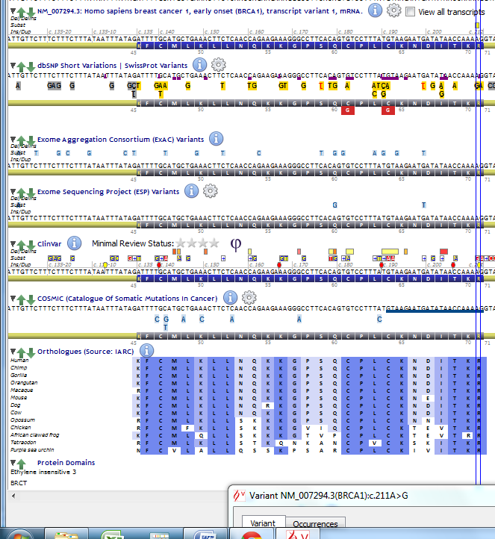
Conservation
Multiple Species alignment:
Bases and motifs conserved across species suggest that it is functionally important
Greater evolutionary distance = more conserved

Slide 23
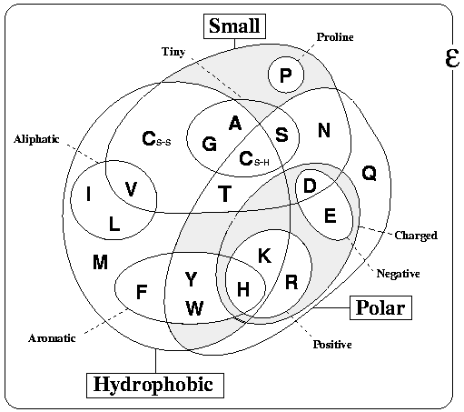
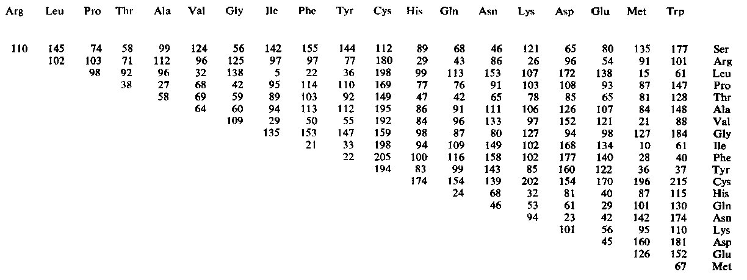
Amino Acid change
Amino acids can be large/small, polar/unpolar.
A drastic change can have a greater effect on the protein function/folding.
The grantham score measures the difference.

Slide 24
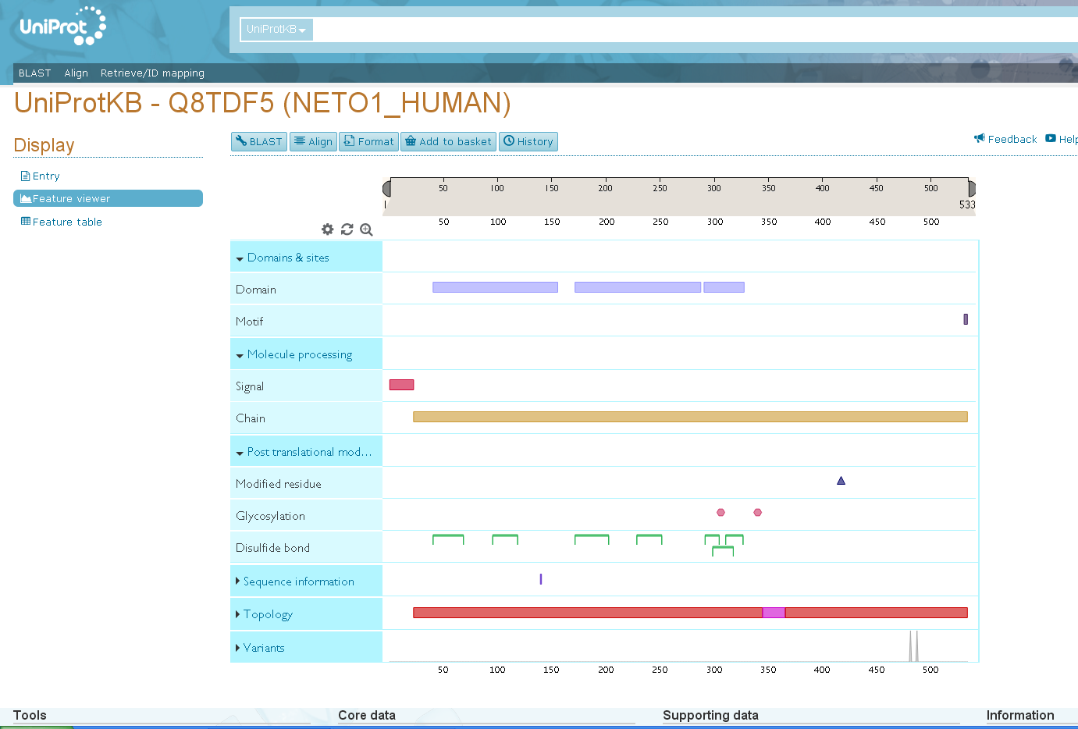
Protein Domains
Databases such as Swissprot and Uniprot characterise proteins and their functional domains.
Mutations within these domains can affect function

Slide 25
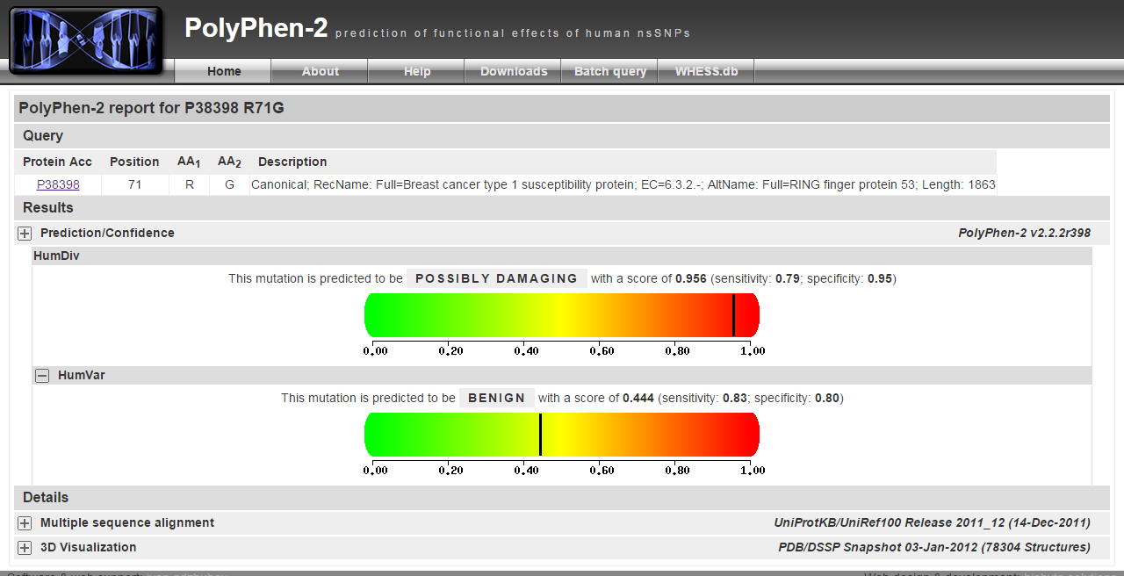
PolyPhen
SIFT
Align GVGD
Mutation Taster
conservation (multiple sequence alignment)
physiochemical differences
proximity of the substitution to predicted functional domains and/or structural features.
conservation (multiple sequence alignment)
conservation (multiple sequence alignment)
Physiochemical differences
Uses the frequency of the AA exchange in known disease causing mutations and polymorphisms for the classification.

Slide 26
But beware
Tools are predictive
Tools often disagree
Should only ever use them in support of other evidence.

Slide 27
Splicing
Mutations can disrupt or create splice sites, creating extended or truncated exons
Tools include:
GeneSplicer, Human Splice Finder, MaxEntScan, NetGene2, NNSplice and SSFL
As per the best practice guidelines these tools are predictive so a consensus of multiple tools should be sought.
Functional studies (mRNA) are the gold standard for splice site investigation.

Slide 28
Phenotype
Ontologies

Slide 29
Ontologies
An ontology is a computational representation of a domain of knowledge based upon a controlled, standardized vocabulary for describing entities and the semantic relationships between them.

Slide 30
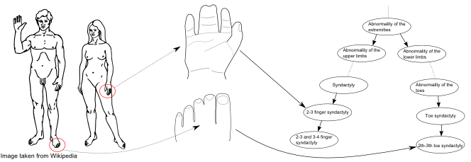
Ontologies

Slide 31
Human Phenotype Ontology (HPO)
Aims to provide a standardized vocabulary of phenotypic abnormalities encountered in human disease
10,088 classes (terms)
13,326 subclass relations between the HPO classes
Each HPO class defined using terms from ontologies for anatomy, cell types, function, embryology, pathology and other domains
Annotations of 7,278 human hereditary syndromes listed in OMIM, Orphanet and DECIPHER
Allows interoperability with several resources, especially those containing phenotype information on model organisms such as mouse and zebrafish.
Köhler S, et al. , Nucl. Acids Res. (2014) 42 (D1): D966-D974 The Human Phenotype Ontology project: linking molecular biology and disease through phenotype data

Slide 32
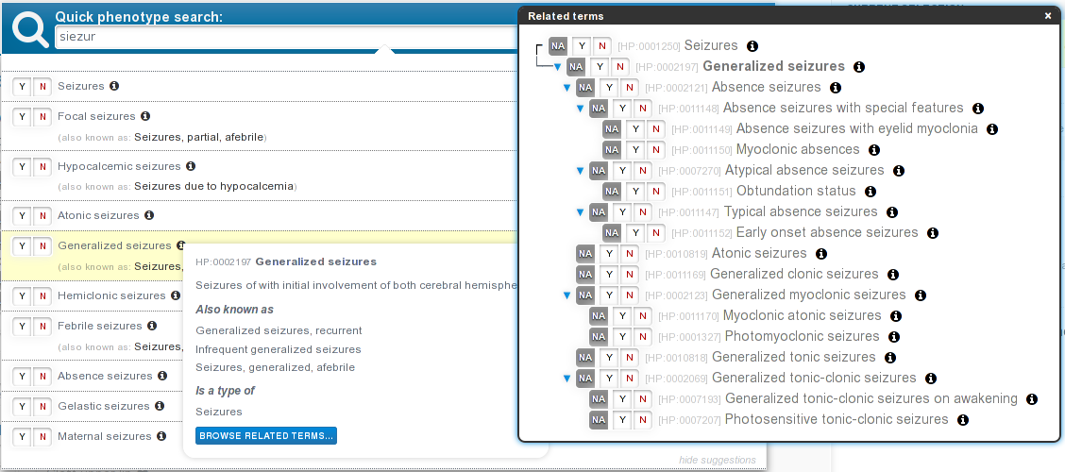
Phenotips
Phenotips captures HPO terms https://playground.phenotips.org

Slide 33
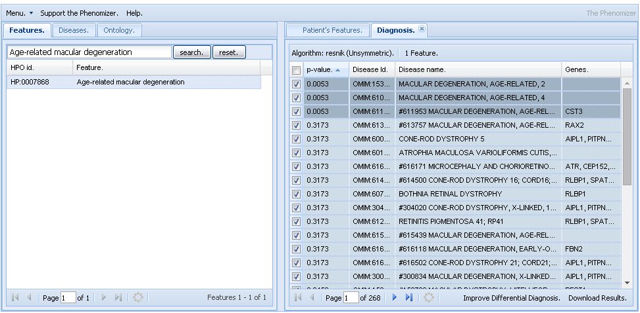
Phenomiser
https://compbio.charite.de/phenomizer/

Slide 34
Other Ontologies
Gene Ontology
Used for Gene Annotation - the practice of capturing data about a gene product (cellular component, molecular function, biological process)
SNOMED-CT (Systematized Nomenclature of Medicine Clinical Terms)
A comprehensive and precise clinical health terminology
Enables consistent, processable representation of clinical content in electronic health records
Mammalian Phenotype Ontology (http://www.informatics.jax.org/searches/MP_form.shtml)
Phenotypes seen in Mice and Rats - linked to mouse models

Slide 35
Other Ontologies
Orphanet
An inventory of rare disorders indexed with OMIM, ICD-10, UMLS, MeSH, MedDRa.
ICD-10 International Statistical Classification of Diseases and Related Health Problems
Codes for diseases, signs and symptoms, abnormal findings, complaints, social circumstances, and external causes of injury or diseases.
MeSH
MeSH is the US National Library of Medicine's controlled vocabulary thesaurus
NML uses to indexing articles from 5,400 of the world's leading biomedical journals for the MEDLINE®/PubMED® database.

Slide 36
So that’s what we want to do
How?!!?

Slide 37
Annotation

Slide 38
Annotation
In order to filter variants the vcf can be annotated with additional information.
Tools to perform this include:
ANNOVAR **
JANNOVAR
VEP
**(freely available to personal, academic and non-profit use only)

Slide 39
Annotation - Annovar
Gene based annotation:
Can add any information about any genes that a variant falls within
Region based annotation:
Annotates if within a conserved region/ cytoband/transcription factor binding site etc
Filter based annotation:
Annotates if present in variant databases (dbSNP,ExAC,1000 GP)

Slide 40
Annotation - Annovar
A perl script which adds annotations into the INFO field
Need to download or create files to annotate from.
Bed format with 6 columns:
Chr Start Stop Ref Alt Annotation
Annovar annotates the INFO field in the vcf with the value in the 6th column where the chr, start, stop ref and alt* match.
*Not all annotation software takes into account the alt allele

Slide 41
How to filter???

Slide 42
Prioritisation

Slide 43
A number of tools are available:
The vcf can be uploaded to one of a few tools along with HPO terms to prioritise variants.

Slide 44
Exomiser

Slide 45
Exomewalker

